Slide 1
Making Managers :
Practiced Skills Online
Tim Perlick
Managerial Skills - MBA
Tim.Perlick@Rutgers.edu

Slide 2
Tim Perlick
Role at Rutgers School of Business:
Tim Perlick is Senior Leadership Facilitator at the Rutgers University-School of Business Camden campus. Tim has created and delivered leadership and management development programs for leading organizations including CME Group (USA), Cisco Systems (USA), Flextronics International (Singapore), General Electric (USA), Caterpillar (USA), HCL (India), Becks Beer (Germany), Graybar Electric Company (USA), ABB (Switzerland), Thomas & Betts (USA), Elektra Stores (Mexico), Banco Azteca (Mexico) and TV Azteca (Mexico).
Tim earned his undergraduate degree from Stanford University and his MBA from the University of Chicago.
tim.perlick@gmail.com

Slide 3
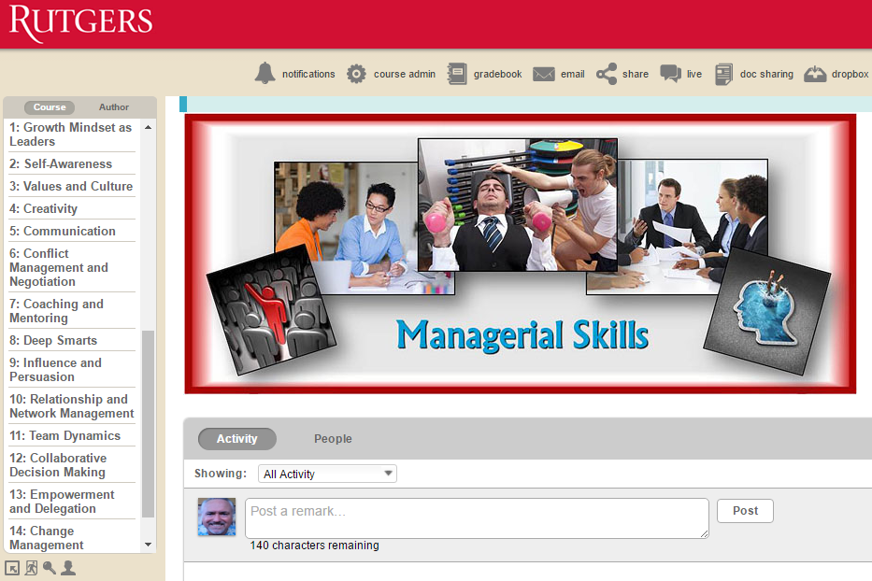

Slide 4
Making Managers:
Applying 3 E of Professional Development

Slide 5
3 E for Professional Development
Education : Introduces new ideas and concepts : Content Delivery
Exposure : Model new concepts through shared experiences : Instructor & Peer Feedback
Experience : Apply new concepts to real world challenges : Applied Work Assignments
Charles Jenning
http://charles-jennings.blogspot.com/
Notes:
Charles Jennings defended his initial work with CLC that developed this heuristic for professional development of High Potentials
Self reported so not empirically data driven
Direction rather than specific (more focus and time on experience than on formal training)
NEW INSIGHTS:
Development Methodology Framework Extension
Cisco : 3 Es of Education, Exposure, Experience
Citibank : 3Ps of Programs, People, Practice
Mix difference based on organizational context

Slide 6
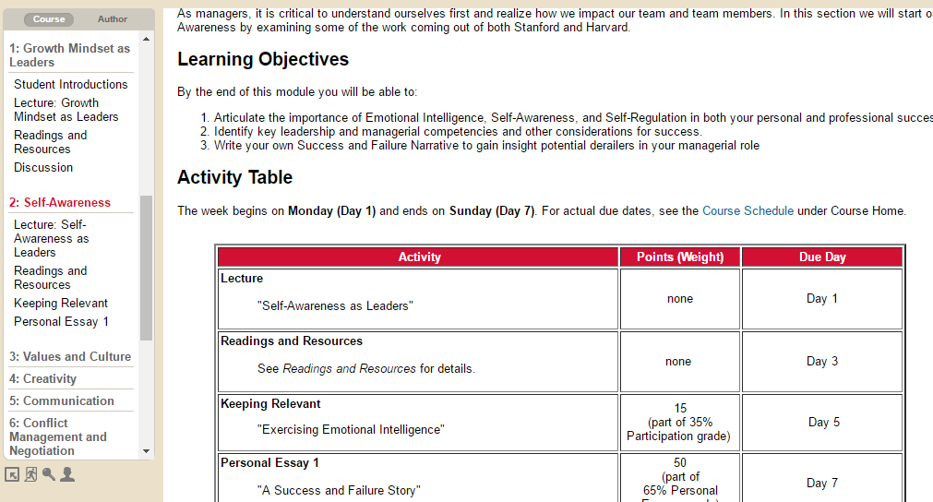
Applying 3 E in Curriculum Development

Slide 7
Making Managers:
Practiced Skills Online

Slide 8
3 Levels of Practice
Keeping Relevant : Sharing Insights and Perspectives
Record Your 60 – 90 Second Provocative Insight
Each participant responds with 30-60 seconds of response
Role Playing : Practicing with Feedback
Model the Expected Behavior and explain how the lessons were applied
Each participant records their Role Play
Instructor and peers provide feedback to improve
Simulation : Applying Best Practices in Scenario
Nested Decision Based scenario with reinforcing messaging and behaviors
Team based analysis on best approach with peer feedback

Slide 9
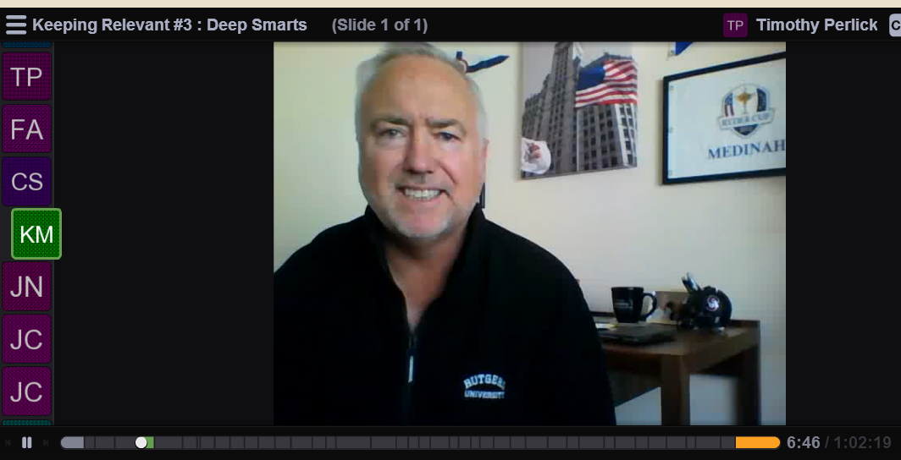
Keeping Relevant : Sharing Insights & Perspectives

Slide 10
Role Playing : Education

Slide 11
Role Playing : Exposure

Slide 12
Role Playing : Experience with Feedback

Slide 13
Simulation : Apply Best Practices in Scenario

Slide 14
Team Presentation & Peer Feedback

Slide 16
Education : Introduce New Idea

Slide 17
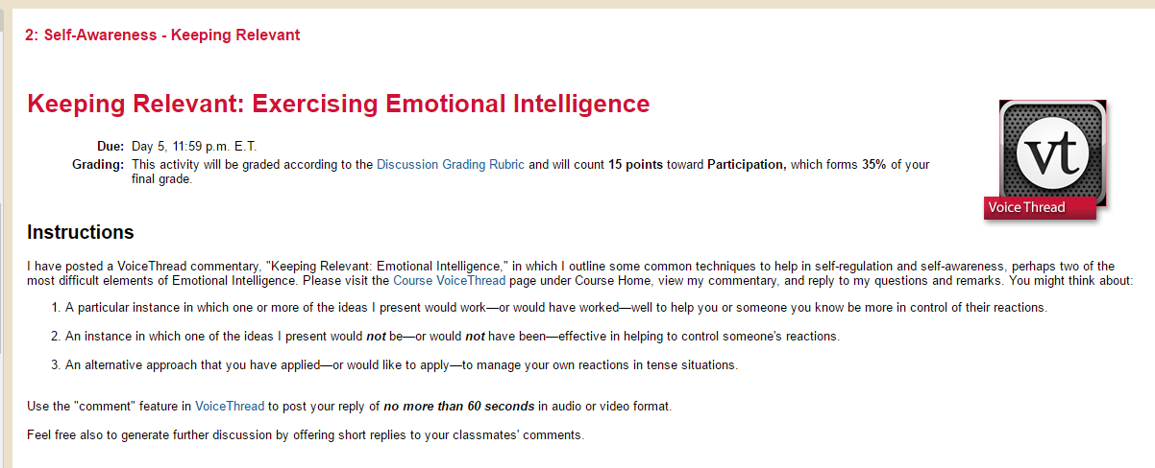
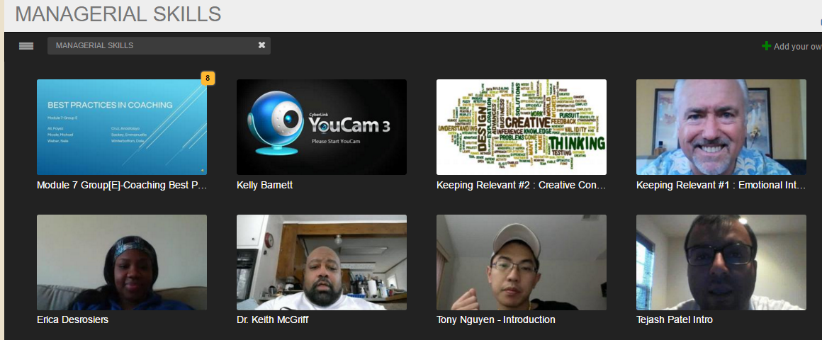
Exposure : Model New Idea

Slide 18
Experience : Apply New Idea

